Slide 1


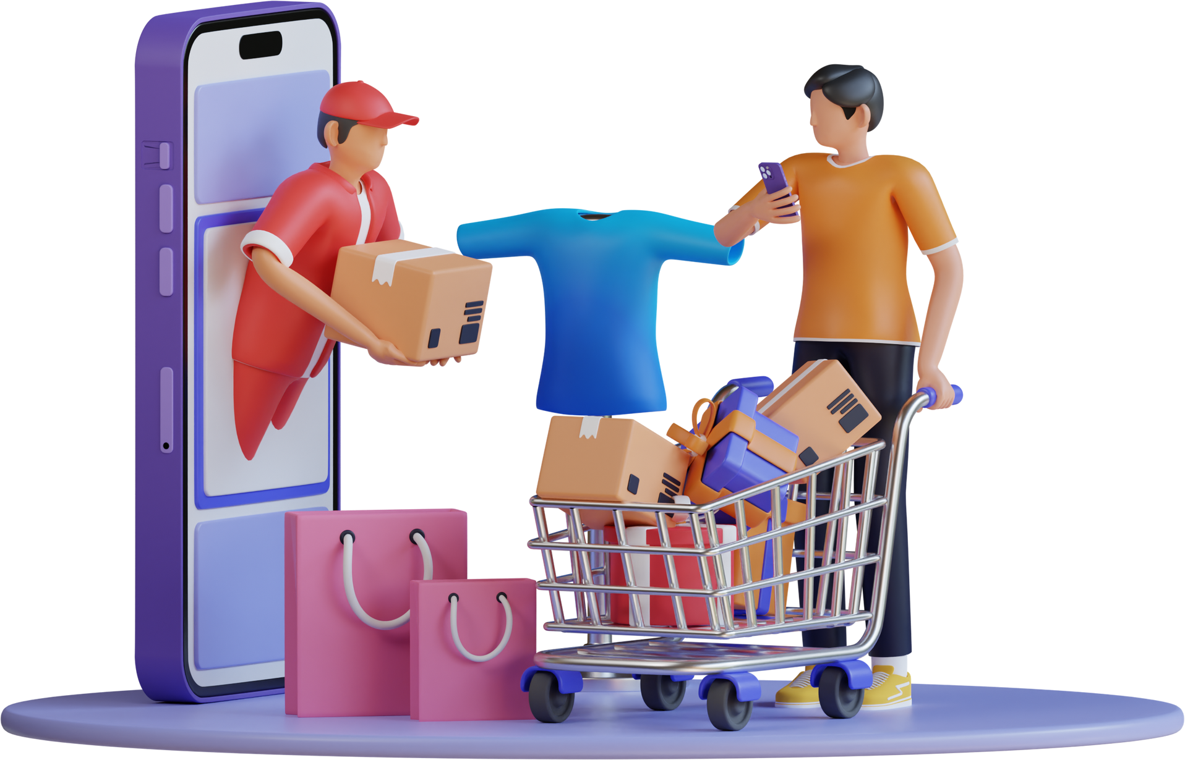

UNDERSTANDING CUSTOMER BEHAVIOUR
GROUP 7

Slide 2


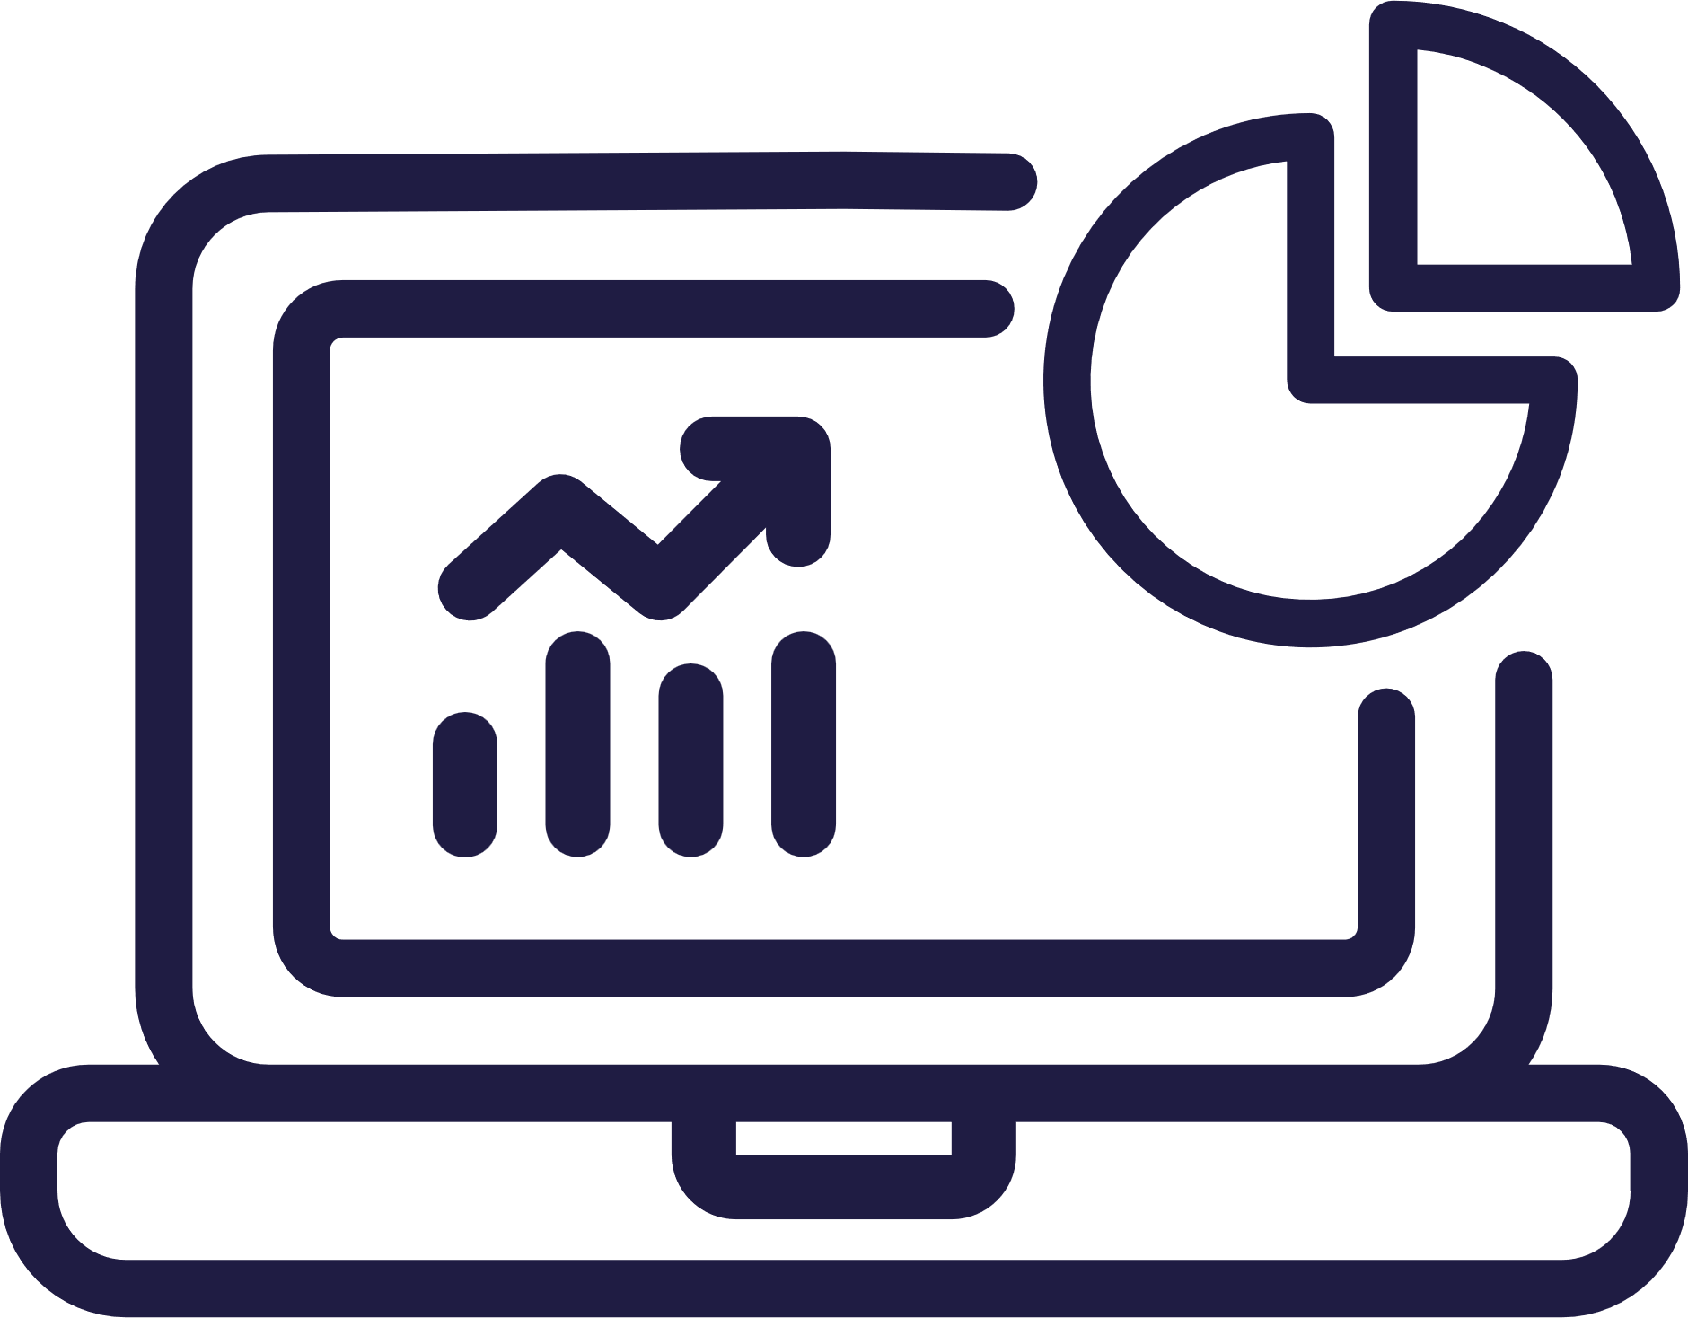
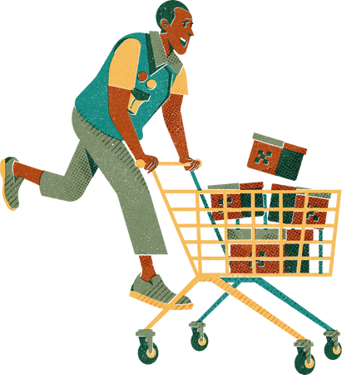
WHAT IS CUSTOMER BEHAVIOR?
CUSTOMER BEHAVIOR REFERS TO AN INDIVIDUAL’S BUYING HABITS, INCLUDING SOCIAL TRENDS, FREQUENCY PATTERNS, AND BACKGROUND FACTORS INFLUENCING THEIR DECISION TO BUY SOMETHING.
UNDERSTANDING THESE DETAILS HELPS BUSINESSES COMMUNICATE WITH CUSTOMERS IN A PRODUCTIVE AND DELIGHTFUL WAY.

Slide 3

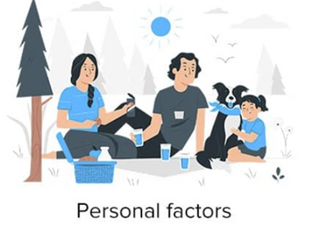
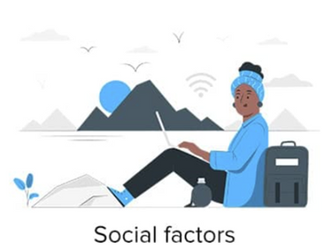
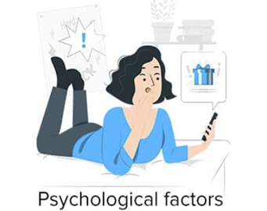
Factors affecting customer behavior
Personal factors include demographic factors such as age, gender, income, occupation, etc. It also depends on one’s interests and opinions.
Social factor includes social class, level of education, religious and ethnic background, family, friends, or social network.
Psychological factors include a person’s ability to understand information, perception of needs, and mindset influence consumer behavior.

Slide 4


ANALYSIS

Slide 5
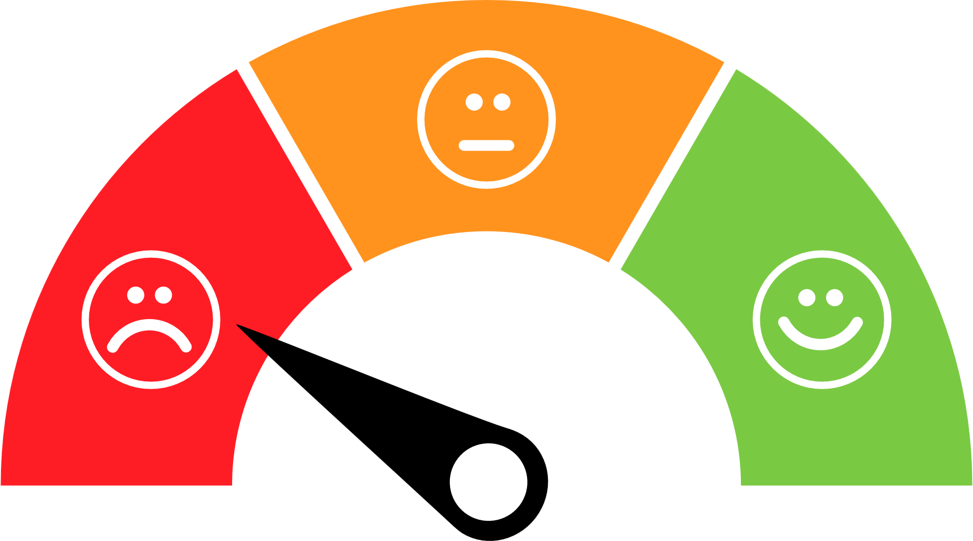




CUSTOMERS WHO LEFT
The company lost 14.5% of its customers i.e, approximately 483 customers
Customers who left
14.5%
3333 Customers
Let's find out the various aspects that could be a potential influence for the customer to leave the company.
Customers who stayed
85.5%

Slide 6
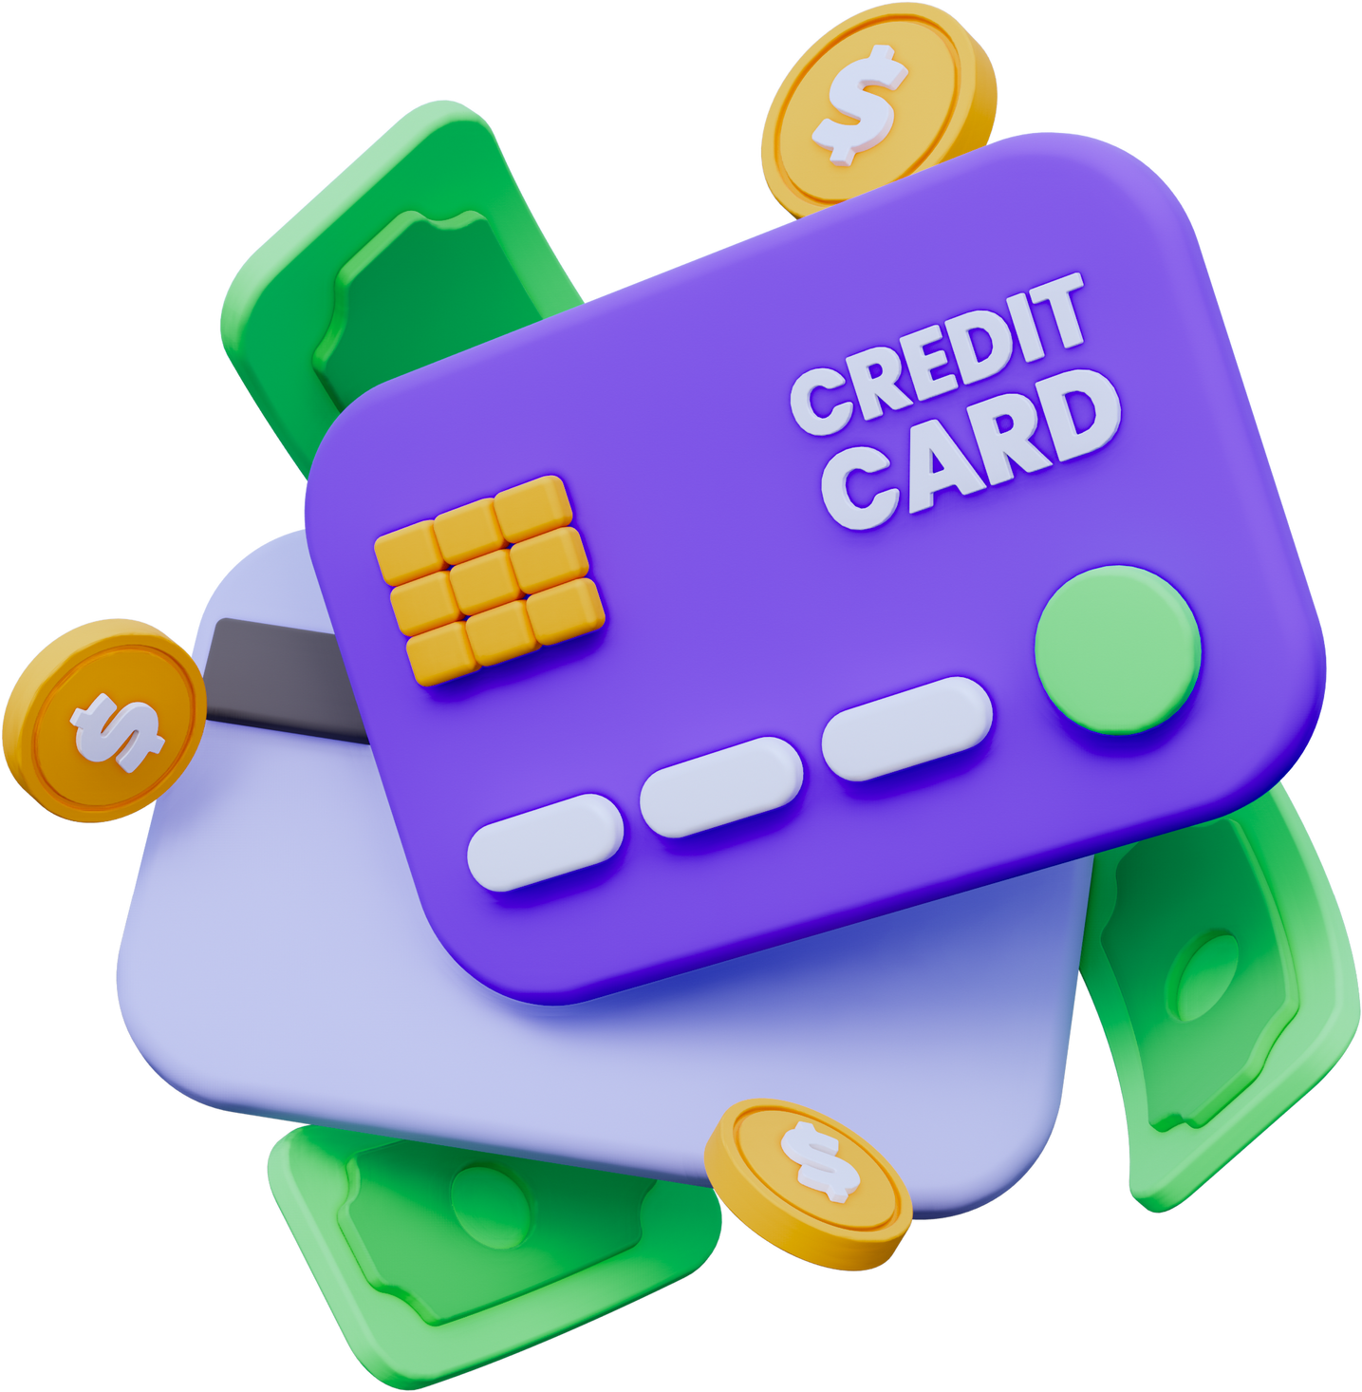
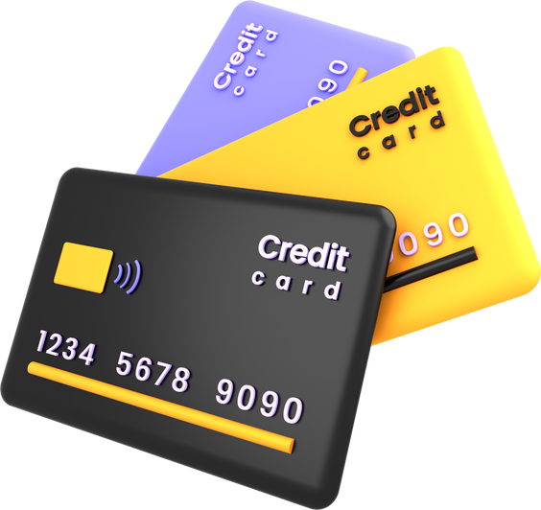
Retention Rates of Consumers with saved credit card information
Customers with Saved Credit Card Information Exhibit Higher Retention Rates
137 OUT OF 483
consumers who had their credit card info saved left the company which is approximately 28.36% of the consumers.
Emphasize robust security measures and transparent data handling to build trust.
Respect consumer choice and continuously improve the process based on feedback.

Slide 7
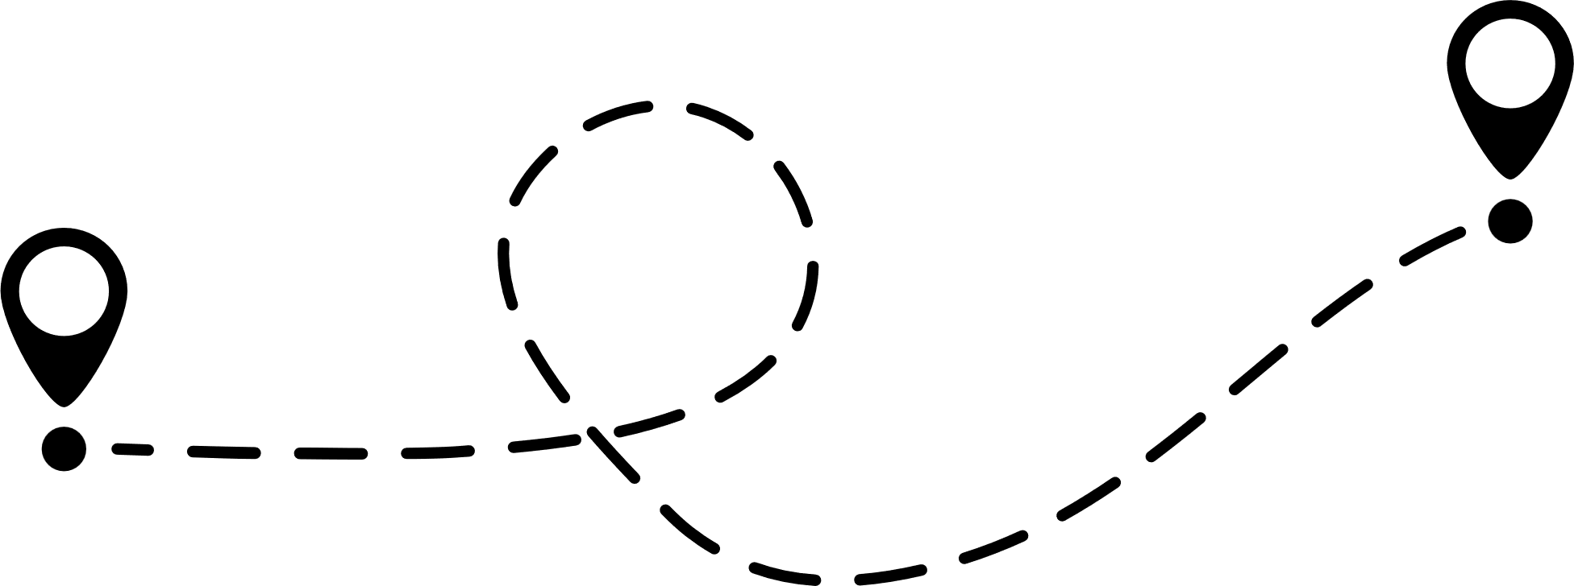
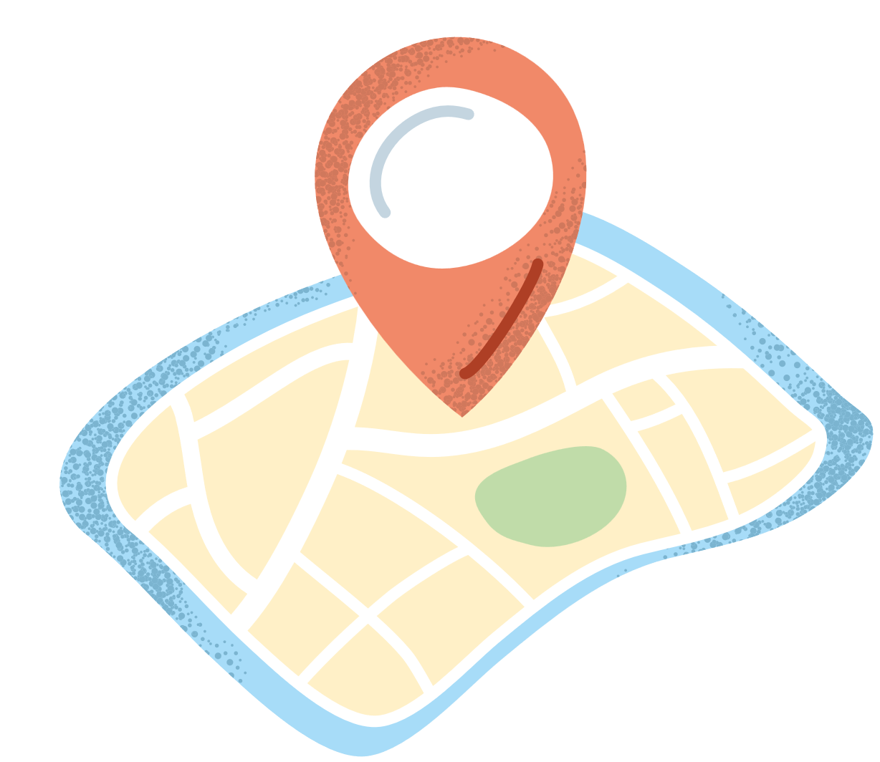

CHURN ANALYSIS BY LOCATION CODE
The Location Code '415' Exhibits the Highest Customer Churn Rate, Indicating Geographic Variation in Customer Retention.
415
510
408
250
+24K
236
200
Tailor marketing and promotional strategies to meet the specific needs and preferences of customers in that location.
Consider cultural, demographic, and regional factors.
Create special offers or incentives for customers in the high-churn location.
+10K
150
Customers who left
125
122
+50K
100
+19K
50
0
415
510
408
Location Code

Slide 8
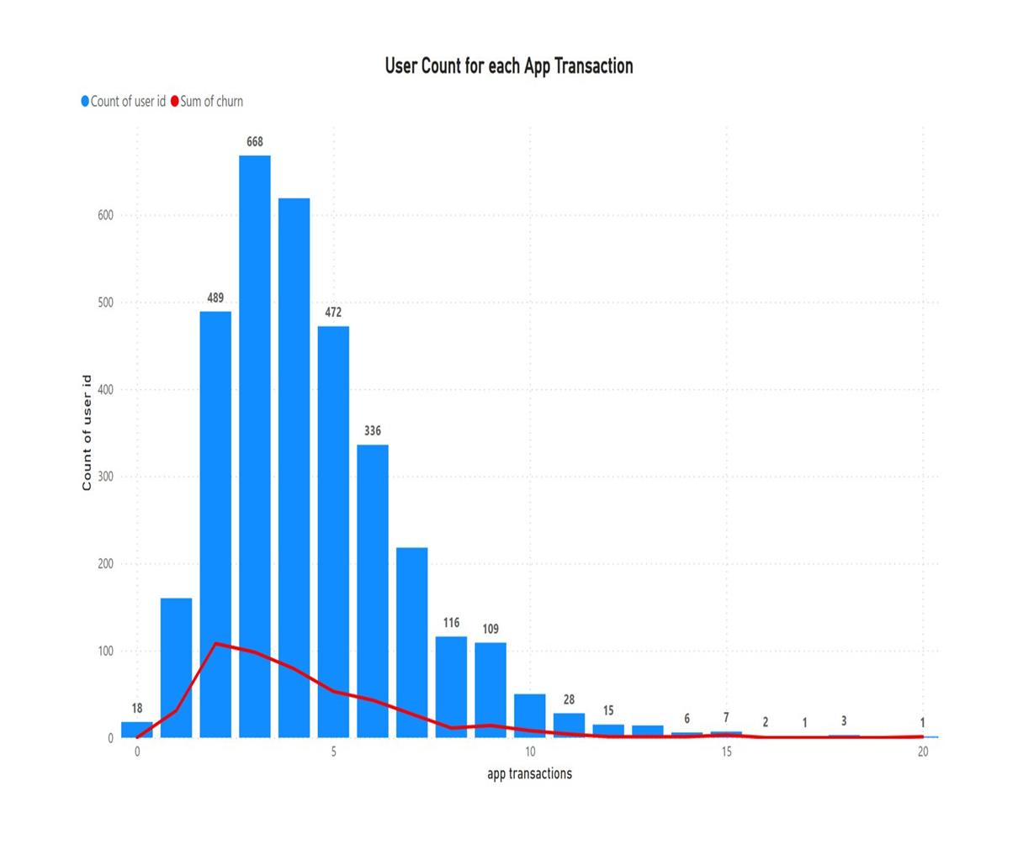

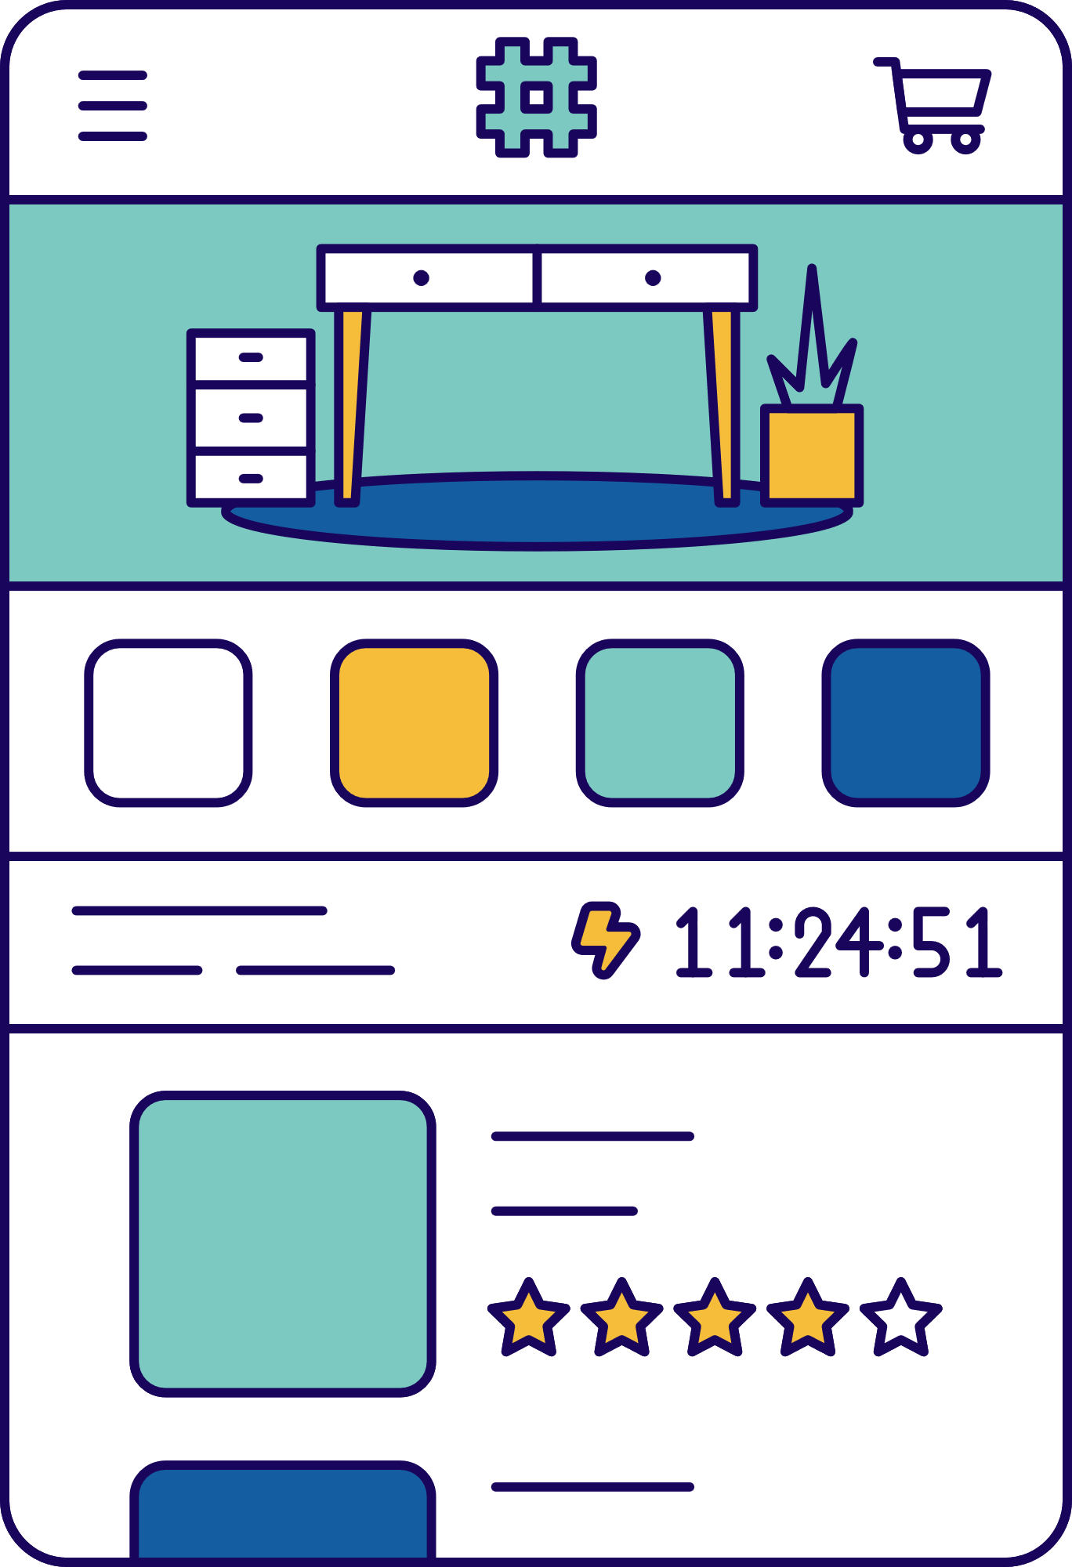
USER COUNT BASED ON NUMBER OF APP TRANSACTIONS
The highest churn rate is observed among customers with three app transactions, with a decreasing trend as the number of app transactions increases.
+24K
Examine the underlying causes for the elevated churn rate in the group of customers with three app transactions.
Develop strategies to captivate these customers, such as offering personalized recommendations and implementing loyalty programs.
+10K
+50K
+19K

Slide 9

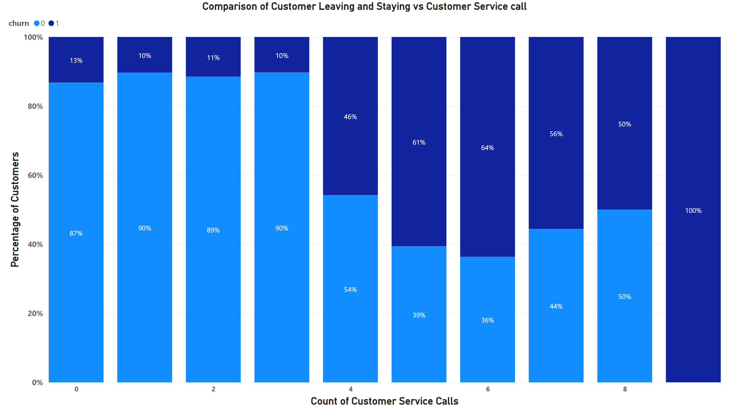

CUSTOMER CHURN ANALYSIS BASED ON CUSTOMER SERVICE CALLS
Here we see that the proportion of people leaving the company were significantly higher after the 3rd call, with maximum being for the 6th call.
Focus on reducing customer churn amongst those who make 3 calls or more, as this is a high-risk group.
Implement proactive customer engagement strategies to address issues before they escalate to requiring a call more than 3.
Enhance self-service options and user-friendly resources to empower customers to find answers independently.
+10K
+50K
+19K

Slide 10
SUMMARY
Model | Accuracy | Precision | Recall | F1 Score
Logistic Model | 86% | 100% | 85% | 93%
Random Forest | 95% | 95% | 68% | 79%
Decision Tree | 91% | 92% | 76% | 75%

Slide 11
WHY F1 SCORE?
PRECISION TELLS US HOW MANY OF THE CUSTOMERS THAT OUR MODEL PREDICTED AS CHURN WHILE
recall tells us how many of the actual churners our model was able to detect
F1 score balances these two metrics and gives us a single number that reflects the overall quality of our model. A high F1 score means that our model has both high precision and high recall, which is desirable for our churn analysis. A low F1 score means that either our model is missing many churners (low recall) or predicting many false churners (low precision), which is not good for the business.
We use F1 Score metric to measure how well our model can identify the customers who are likely to leave our service and also how accurate our model is with those predictions. The f1 score is a harmonic mean of precision and recall, two important aspects of classification performance.

Slide 12

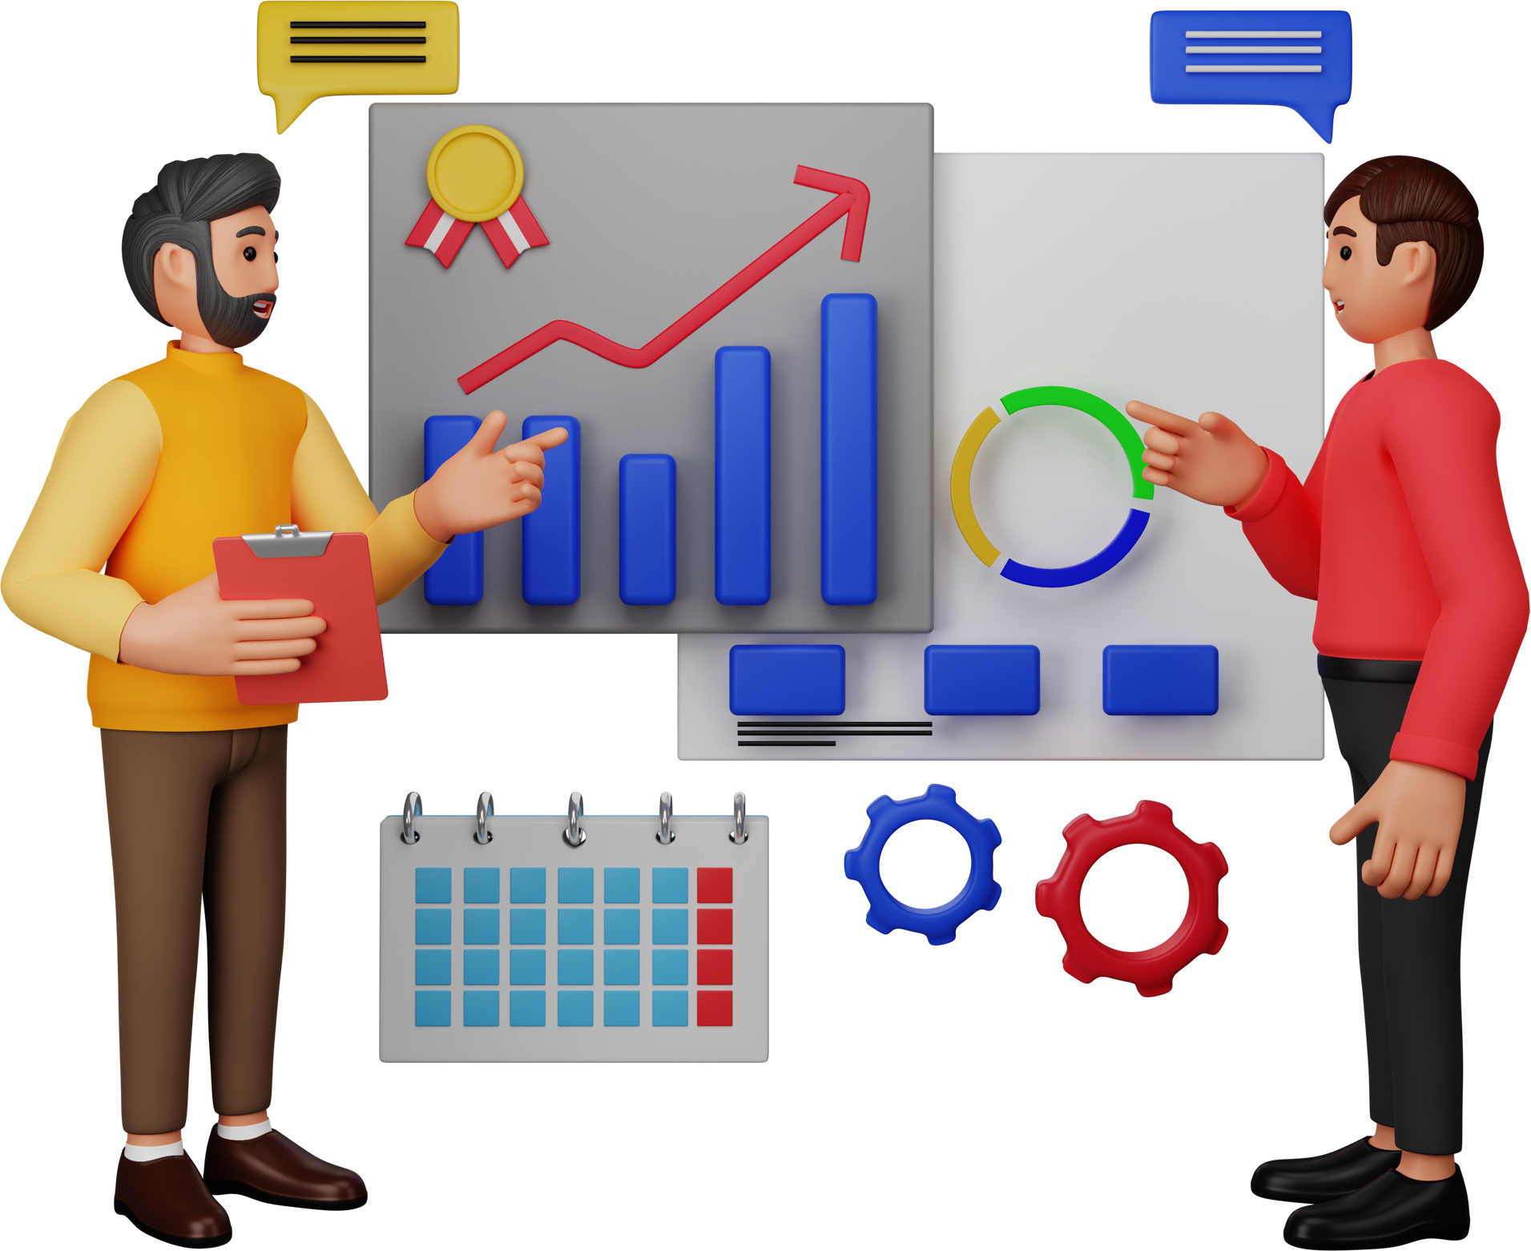
Strategies and Suggestions
Tailored Marketing: Customize marketing strategies to align with location-specific customer needs and preferences, considering cultural and demographic factors.
Special Offers: Create enticing offers and incentives for high-churn locations to foster customer loyalty and encourage repeat purchases.
High-Risk Group: Focus on reducing churn among customers with zero or one customer service call, as they are at higher risk of leaving.
Proactive Engagement: Implement proactive customer engagement strategies to address issues before they escalate to the point of requiring a service call.
App Transaction Engagement: Investigate and address the reasons behind high churn rates among customers with three app transactions. Develop engagement strategies, such as personalized recommendations and loyalty programs, to retain these customers.

Slide 13
THANK YOU

